Slide 1
CHAPTER 5
Multivariate Probability Distributions

Slide 2
OBJECTIVES
Covariance

Slide 3
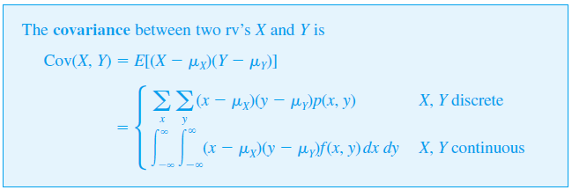
Covariance
When two random variables X and Y are not independent, it is frequently of interest to assess how strongly they are related to one another.
That is, since (X – μ_{X} ) and (Y – μ_{Y} ) are the deviations of the two variables from their respective mean values, the covariance is the expected product of deviations.
Note that
Cov(X, X) = E[(X – μ_{X})²]
= V(X).

Slide 4
Covariance
The rationale for the definition is as follows.
Suppose X and Y have a strong positive relationship to one another, by which we mean that large values of X tend to occur with large values of Y and small values of X with small values of Y.
Then most of the probability mass or density will be associated with (x – μ_{X}) and (y – μ_{Y}), either both positive (both X and Y above their respective means) or both negative, so the product (x – μ_{X})(y – μ_{Y}) will tend to be positive.
Thus for a strong positive relationship, Cov(X, Y) should be quite positive.
For a strong negative relationship, the signs of (x – μ_{X}) and (y – μ_{Y}) will tend to be opposite, yielding a negative product.
Thus for a strong negative relationship, Cov(X, Y) should be quite negative.
If X and Y are not strongly related, positive and negative products will tend to cancel one another, yielding a covariance near 0.

Slide 5
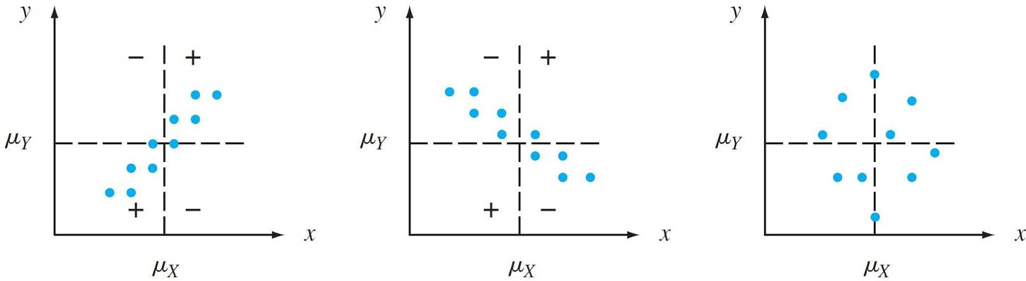
Covariance
Figure below illustrates the different possibilities.
The covariance depends on both the set of possible pairs and the probabilities.
p(x, y) = 1/10 for each of ten pairs corresponding to indicated points:
(a) positive covariance;
(b) negative covariance;
(c) covariance near zero

Slide 6
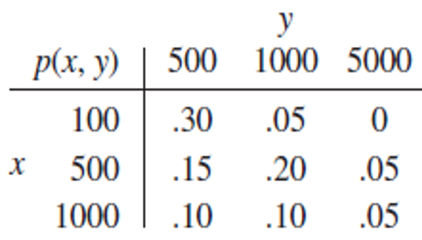
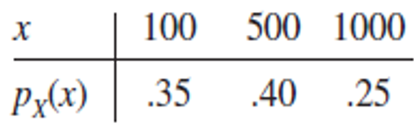
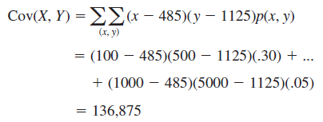
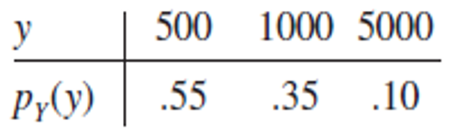
Example
The joint and marginal pmf’s for
X = automobile policy deductible amount and
Y = homeowner policy deductible amount
Therefore,

Slide 7

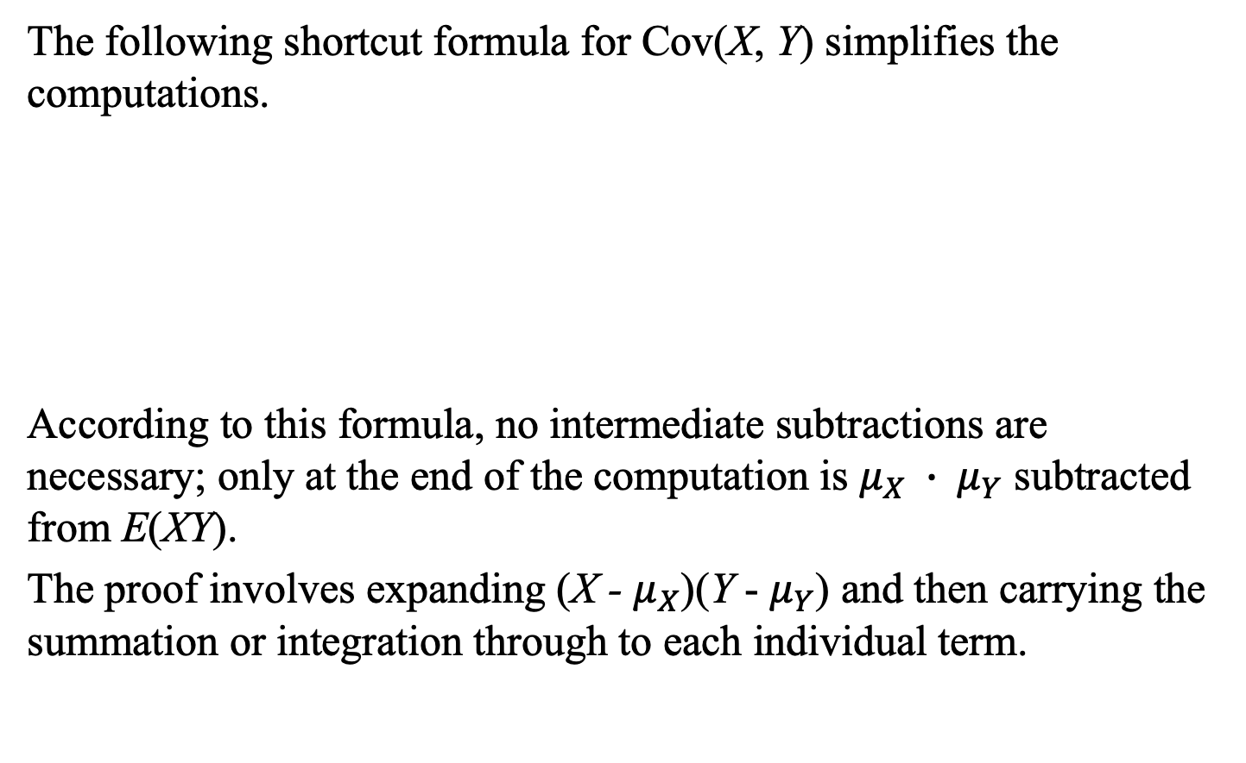
Covariance
The following shortcut formula for Cov(X, Y) simplifies the computations.
According to this formula, no intermediate subtractions are necessary; only at the end of the computation is $μ_{X} ∙ μ_{Y}$ subtracted from E(XY).
The proof involves expanding (X - $μ_{X}$)(Y - $μ_{Y}$) and then carrying the summation or integration through to each individual term.

Slide 8
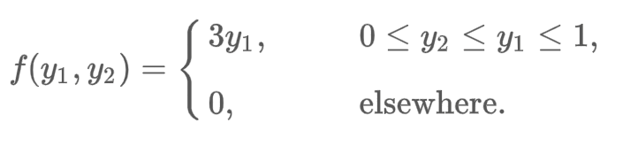
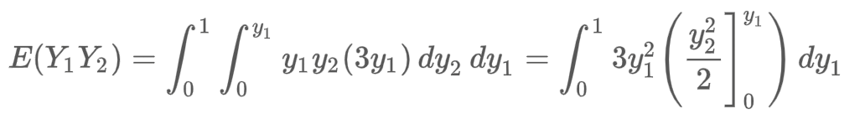
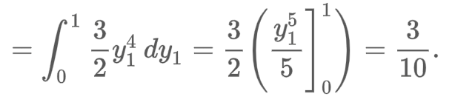

Example
Y₁ and Y₂ have joint density function given by
Find Cov(Y₁,Y₂).

